Slide 1
Unit 6 NOSQL Databases and Data Warehousing

Slide 2
Contents
NOSQL Databases :
Introduction to NOSQL Databases,
Types of NOSQL Databases
BASE properties
CAP theorem
Data Warehousing: Architecture and Components of Data Warehouse, OLAP

Slide 3
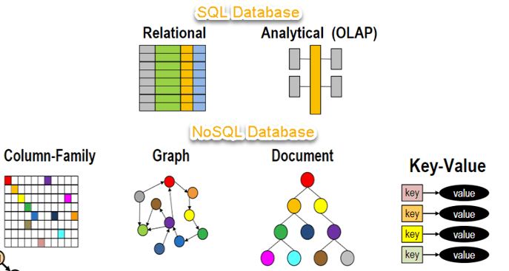
NoSQL databases "not only SQL"
NoSQL databases (aka "not only SQL") are non-tabular databases and store data differently than relational tables.
NoSQL databases come in a variety of types based on their data model. The main types are document, key-value, wide-column, and graph.
Traditional RDBMS uses SQL syntax to store and retrieve data for further insights. Instead, a NoSQL database system encompasses a wide range of database technologies that can store structured, semi-structured, unstructured data.

Slide 4
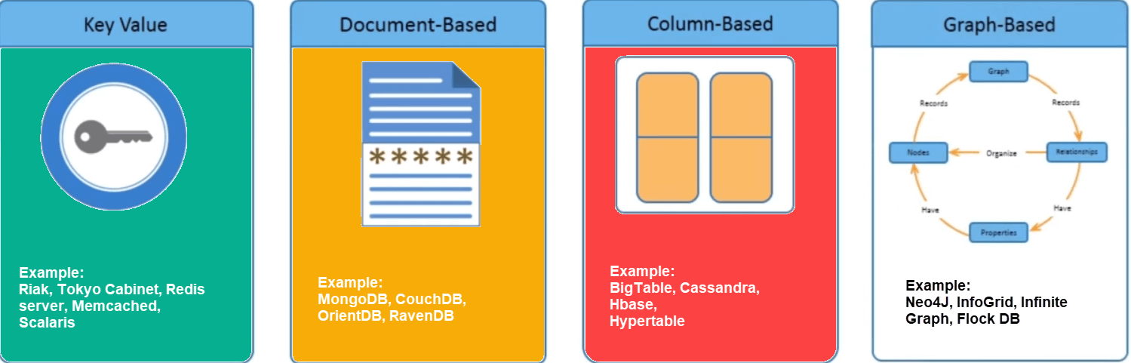
Types of NoSQL databases
NoSQL Databases are mainly categorized into four types: Key-value pair, Column-oriented(Wide-column), Graph-based and Document-oriented. Every category has its unique attributes and limitations

Slide 5
Types of NoSQL databases
Key Value Pair Based
Data is stored in key/value pairs. It is designed in such a way to handle lots of data and heavy load.
Key-value pair storage databases store data as a hash table where each key is unique, and the value can be a JSON, BLOB(Binary Large Objects), string, etc.
This kind of NoSQL database is used as a collection, dictionaries, associative arrays, etc. Key value stores help the developer to store schema-less data. They work best for shopping cart contents.
Redis, Dynamo, Riak are some NoSQL examples of key-value store DataBases.

Slide 6
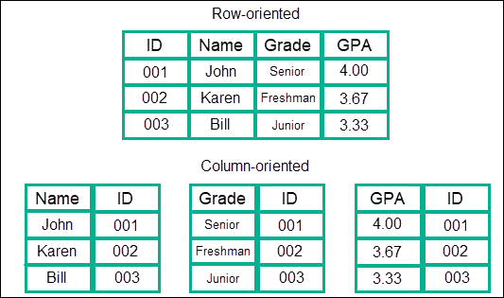
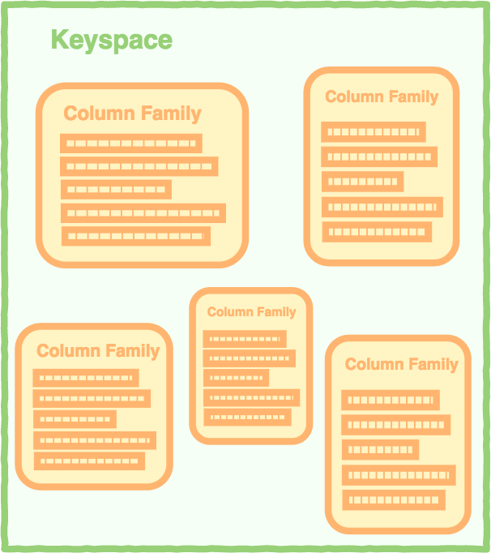
Types of NoSQL databases
Column-based
Column-oriented databases work on columns and are based on BigTable paper by Google. Every column is treated separately.
More specifically, column databases use the concept of keyspace, which is sort of like a schema in relational models. This keyspace contains all the column families, which then contain rows, which then contain columns.

Slide 7
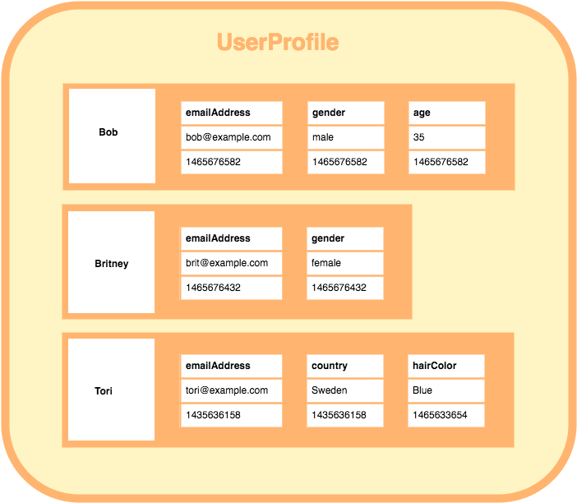
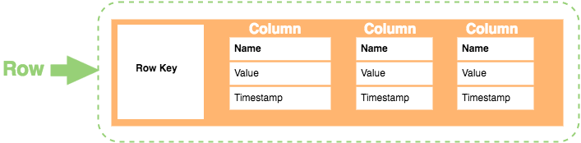
Types of NoSQL databases
HBase, Cassandra, HBase, Hypertable are NoSQL query examples of column based database.

Slide 8
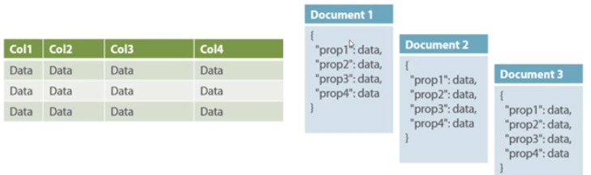
Types of NoSQL databases
Document-Oriented:
Document-Oriented NoSQL DB stores and retrieves data as a key value pair but the value part is stored as a document. The document is stored in JSON or XML formats. The value is understood by the DB and can be queried.
The document type is mostly used for CMS systems, blogging platforms, real-time analytics & e-commerce applications.
Amazon SimpleDB, CouchDB, MongoDB, Riak, Lotus Notes, MongoDB, are popular Document originated DBMS systems.

Slide 9
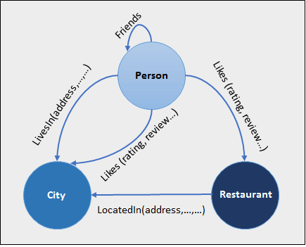
Types of NoSQL databases
Graph-Based
A graph type database stores entities as well the relations amongst those entities. The entity is stored as a node with the relationship as edges.
An edge gives a relationship between nodes. Every node and edge has a unique identifier.
Graph base database mostly used for social networks, logistics, spatial data.
Neo4J, Infinite Graph, OrientDB, FlockDB are some popular graph-based databases.

Slide 10
What is the CAP Theorem?
CAP theorem states that is impossible for a distributed data store to offer more than two out of three guarantees.
Consistency
Availability
Partition Tolerance
Consistency:
The data should remain consistent even after the execution of an operation. This means once data is written, any future read request should contain that data. For example, after updating the order status, all the clients should be able to see the same data.
Availability:
The database should always be available and responsive. It should not have any downtime.
Partition Tolerance:
Partition Tolerance means that the system should continue to function even if the communication among the servers is not stable. For example, the servers can be partitioned into multiple groups which may not communicate with each other. Here, if part of the database is unavailable, other parts are always unaffected.

Slide 11
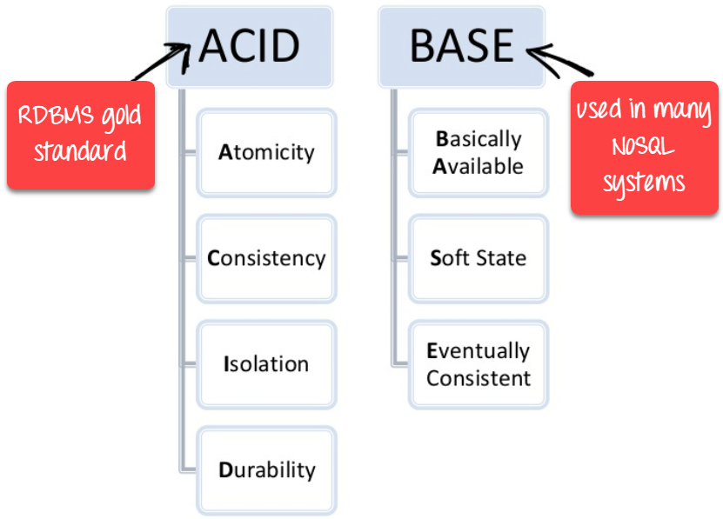
BASE: Basically Available, Soft state, Eventual consistency
Basically, available means DB is available all the time as per CAP theorem
Soft state means even without an input; the system state may change
Eventual consistency means that the system will become consistent over time

Slide 12
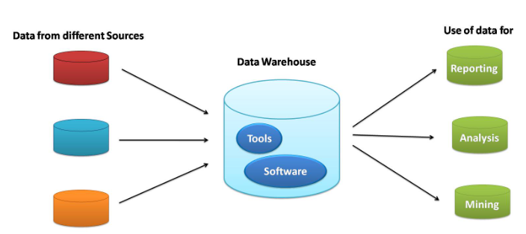
Data Warehousing
A Data Warehousing (DW) is process for collecting and managing data from varied sources to provide meaningful business insights.
A Data Warehouse is a collection of software tools that facilitates analysis of a large set of business data used to help an organization make decisions.
A data warehouse is mainly a data management system that’s designed to enable and support business intelligence (BI) activities, particularly analytics. Data warehouses are alleged to perform queries, cleaning, manipulating, transforming and analyzing the data.
A large amount of data in data warehouses comes from numerous sources such that internal applications like marketing, sales, and finance; customer-facing apps

Slide 13
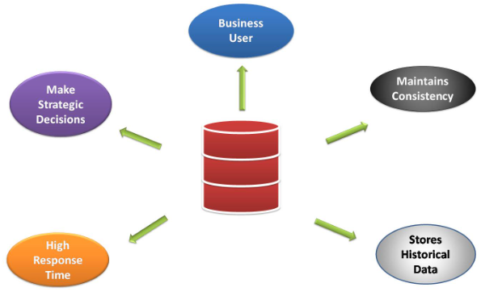
Why You Need a Data Warehouse?
During the early days, you may be using your regular database to run SQL queries for analytics. But, with the increase in the size of the data and individuals using the data to perform various analysis, your regular database becomes extremely slow in query processing.
This is where companies understood the need for Data Warehouse that on the other hand, is designed to handle huge volumes of data. It allows you to swiftly Filter, Sort, Aggregate, and Analyze the data.
It allows organizations to make quality business decisions. The data warehouse benefits by improving data analytics, it also helps to gain considerable revenue and the strength to compete more strategically in the market.

Slide 14
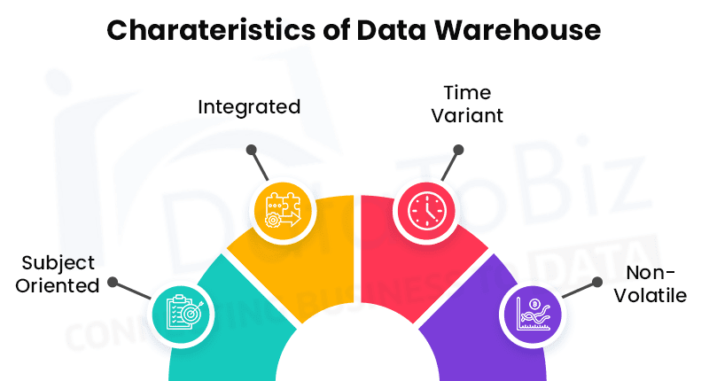
Characteristics of data warehousing
Subject-Oriented
A data warehouse target on the modeling and analysis of data for decision-makers. Therefore, data warehouses typically provide a concise and straightforward view around a particular subject, such as customer, product, or sales, instead of the global organization's ongoing operations.
Integrated
In Data Warehouse, integration means the establishment of a common unit of measure for all similar data from the dissimilar database
Time-Variant
It contains an element of time, explicitly or implicitly.
Non-volatile
Also, the data warehouse is non-volatile, meaning that prior data will not be erased when new data are entered into it

Slide 15
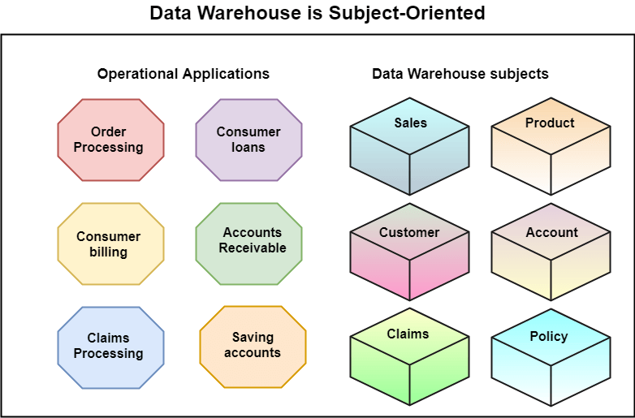
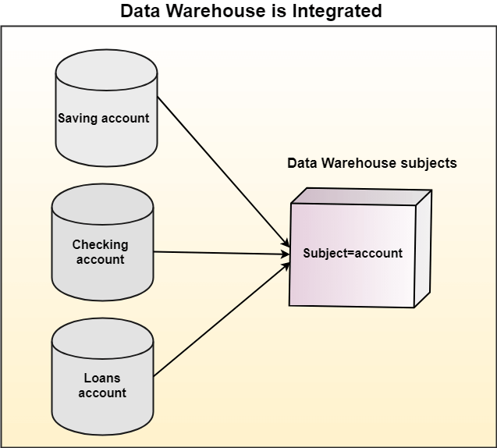

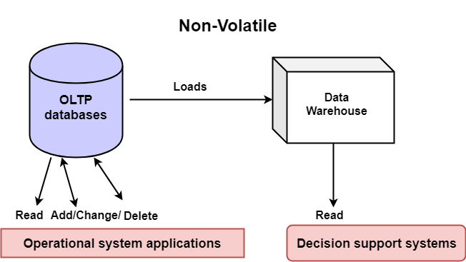
Characteristics of data warehousing

Slide 16
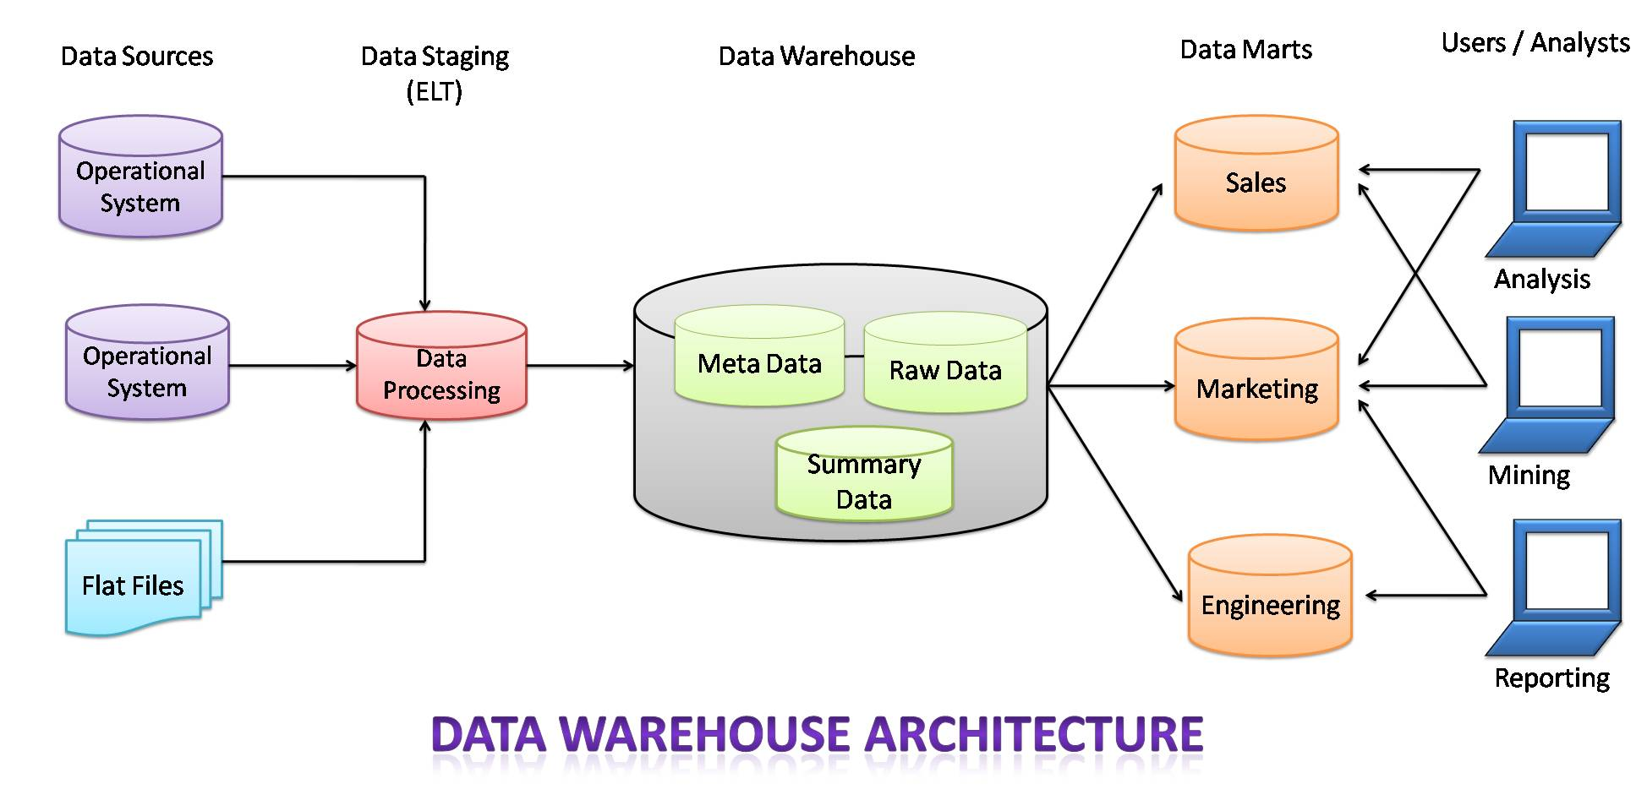
Architecture & Components of Data Warehouse
The architecture of the data warehouse mainly consists of the proper arrangement of its elements, to build an efficient data warehouse with software and hardware components. The elements and components may vary based on the requirement of organizations. All of these depend on the organization’s circumstances.

Slide 17
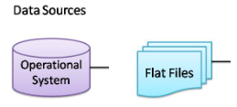
Architecture & Components of Data Warehouse
1. Source Data Component:
In the Data Warehouse, the source data comes from different places. They are group into four categories:
External Data: For data gathering, most of the executives and data analysts rely on information coming from external sources for a numerous amount of the information they use. They use statistical features associated with their organization that is brought out by some external sources and department.
Internal Data: In every organization, the consumer keeps their “private” spreadsheets, reports, client profiles, and generally even department databases.
Operational System data: Operational systems are principally meant to run the business. In each operation system, we periodically take the old data and store it in achieved files.
Flat files: A flat file is nothing but a text database that stores data in a plain text format. Flat files generally are text files that have all data processing and structure markup removed. A flat file contains a table with a single record per line.

Slide 18
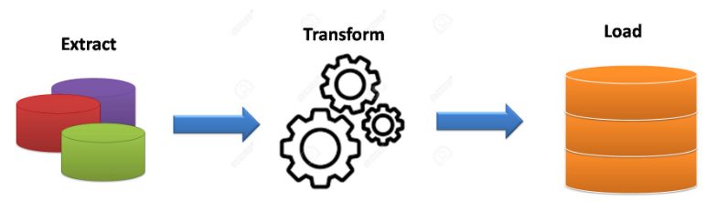
Architecture & Components of Data Warehouse
2. Data Staging: After the data is extracted from various sources, now it’s time to prepare the data files for storing in the data warehouse. The extracted data collected from various sources must be transformed and made ready in a format that is suitable to be saved in the data warehouse for querying and analysis.
Data Extraction: This stage handles various data sources. Data analysts should employ suitable techniques for every data source.
Data Transformation: We tend to perform many individual tasks as a part of information transformation. First, we tend to clean the info extracted from every source of data. Once the data transformation performs ends, we’ve got a set of integrated information that’s clean, standardized, and summarized.
Data Loading: When we complete the structure and construction of the data warehouse we do the initial loading of the data into the data warehouse storage.

Slide 19
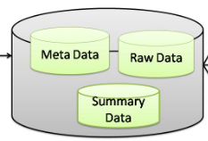
Architecture & Components of Data Warehouse
3. Data Storage in Warehouse: Data storage for data warehousing is split into multiple repositories.
These data repositories contain structured data in a very highly normalized form for fast and efficient processing.
Metadata: Metadata means data about data i.e. it summarizes basic details regarding data, creating findings & operating with explicit instances of data.
Raw Data: Raw data is a set of data and information that has not yet been processed and was delivered from a particular data entity to the data supplier and hasn’t been processed by machine or human.
Summary Data or Data summary: Data summary is an easy term for a brief conclusion of an enormous theory or a paragraph. This is often one thing where analysts write the code and in the end, they declare the ultimate end in the form of summarizing data.

Slide 20
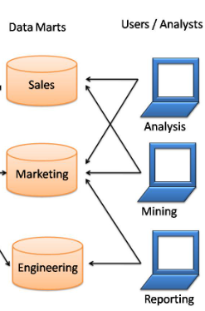
Architecture & Components of Data Warehouse
4. Data Marts:
It can store the information of a specific function of an organization that is handled by a single authority.
There may be any number of data marts in a particular organization depending upon the functions. In short, data marts contain subsets of the data stored in data warehouses.
5. Users/Analysts
Now, the users and analysts can use data for various applications like reporting, analyzing, mining, etc. The data is made available to them whenever required.
https://www.analyticsvidhya.com/blog/2021/07/a-brief-introduction-to-data-warehouse/

Slide 21
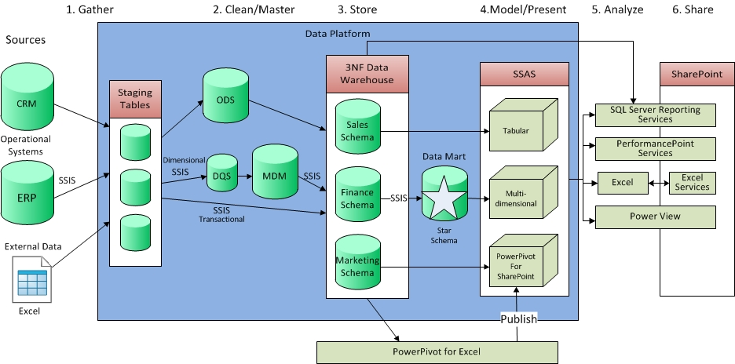
Detail architecture
https://www.jamesserra.com/archive/2013/07/why-you-need-a-data-warehouse/

Slide 22
Online Analytical Processing (OLAP)
OLAP stands for On-Line Analytical Processing. OLAP is a classification of software technology which authorizes analysts, managers, and executives to gain insight into information through fast, consistent, interactive access in a wide variety of possible views of data that has been transformed from raw information to reflect the real dimensionality of the enterprise as understood by the clients.
OLAP implement the multidimensional analysis of business information and support the capability for complex estimations, trend analysis, and sophisticated data modeling.
It is rapidly enhancing the essential foundation for Intelligent Solutions containing Business Performance Management, Planning, Budgeting, Forecasting, Financial Documenting, Analysis, Simulation-Models, Knowledge Discovery, and Data Warehouses Reporting.

Slide 23
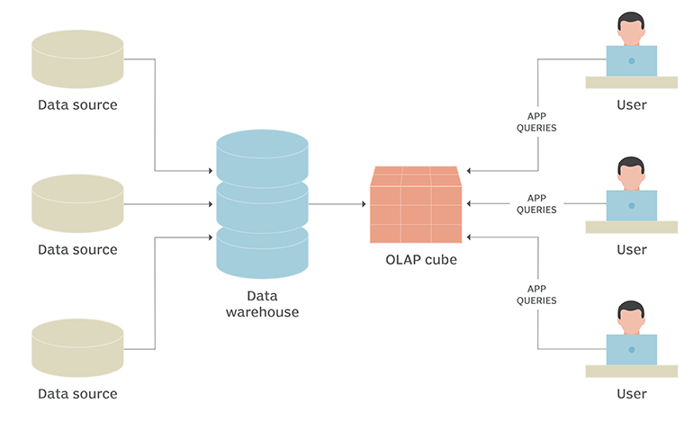
Online Analytical Processing (OLAP)
How OLAP systems work
To facilitate this kind of analysis, data is collected from multiple data sources and stored in data warehouses then cleansed and organized into data cubes.
Each OLAP cube contains data categorized by dimensions (such as customers, geographic sales region and time period) derived by dimensional tables in the data warehouses.
Dimensions are then populated by members (such as customer names, countries and months) that are organized hierarchically.
OLAP cubes are often pre-summarized across dimensions to drastically improve query time over relational databases.
A data cube is a multi-dimensional array of values used to bring together data to be organized and modeled for analysis.

Slide 24
Online Analytical Processing (OLAP)
Analysts can then perform five types of OLAP analytical operations against multidimensional databases:
Roll-up. Also known as consolidation, or drill-up, this operation summarizes the data along the dimension.
Drill-down. This allows analysts to navigate deeper among the dimensions of data, for example drilling down from "time period" to "years" and "months" to chart sales growth for a product.
Slice. This enables an analyst to take one level of information for display, such as "sales in 2017."
Dice. This allows an analyst to select data from multiple dimensions to analyze, such as "sales of blue beach balls in Iowa in 2017."
Pivot. Analysts can gain a new view of data by rotating the data axes of the cube.

Slide 25
Online Analytical Processing (OLAP)
Analysts can then perform five types of OLAP analytical operations against multidimensional databases:
Roll-up. Also known as aggregation operation or drill-up, this operation summarizes the data along the dimension.
Temperature | 64 | 65 | 68 | 69 | 70 | 71 | 72 | 75 | 80 | 81 | 83 | 85
Week1 | 1 | 0 | 1 | 0 | 1 | 0 | 0 | 0 | 0 | 0 | 1 | 0
Week2 | 0 | 0 | 0 | 1 | 0 | 0 | 1 | 2 | 0 | 1 | 0 | 0
Temperature | cool | mild | hot
Week1 | 2 | 1 | 1
Week2 | 2 | 1 | 1
Consider that we want to set up levels (hot (80-85), mild (70-75), cool (64-69)) in temperature from the above cubes.
To do this, we have to group column and add up the value according to the concept hierarchies.
This operation is known as a roll-up.

Slide 26
Online Analytical Processing (OLAP)
Temperature | cool | mild | hot
Day 1 | 0 | 0 | 0
Day 2 | 0 | 0 | 0
Day 3 | 0 | 0 | 1
Day 4 | 0 | 1 | 0
Day 5 | 1 | 0 | 0
Day 6 | 0 | 0 | 0
Day 7 | 1 | 0 | 0
Day 8 | 0 | 0 | 0
Day 9 | 1 | 0 | 0
Day 10 | 0 | 1 | 0
Day 11 | 0 | 1 | 0
Day 12 | 0 | 1 | 0
Day 13 | 0 | 0 | 1
Day 14 | 0 | 0 | 0
Drill-down. This allows analysts to navigate deeper among the dimensions of data, for example drilling down from "time period" to "years" and "months" to chart sales growth for a product.

Slide 27
Online Analytical Processing (OLAP)
Dice. This allows an analyst to select data from multiple dimensions to analyze.
The dice operation describes a subcube by operating a selection on two or more dimension.
For example, Implement the selection (time = day 3 OR time = day 4) AND (temperature = cool OR temperature = hot) to the original cubes we get the following subcube (still two-dimensional)
Slice. This enables an analyst to take one level of information for display, such as "sales in 2017.“
For example, if we make the selection, temperature=cool we will obtain the following cube:
Temperature | cool
Day 1 | 0
Day 2 | 0
Day 3 | 0
Day 4 | 0
Day 5 | 1
Day 6 | 1
Day 7 | 1
Day 8 | 1
Day 9 | 1
Day 11 | 0
Day 12 | 0
Day 13 | 0
Day 14 | 0
Temperature | cool | hot
Day 3 | 0 | 1
Day 4 | 0 | 0

Slide 28
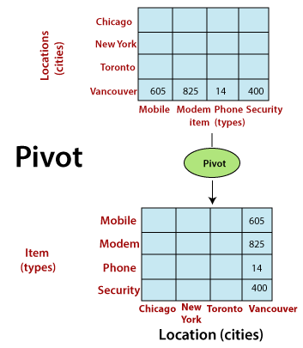
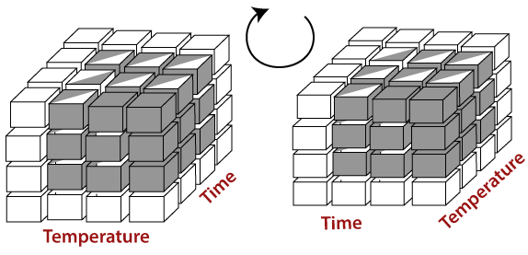
Online Analytical Processing (OLAP)
Pivot. Analysts can gain a new view of data by rotating the data axes of the cube.
It may contain swapping the rows and columns or moving one of the row-dimensions into the column dimensions.

Slide 29
Types of OLAP
There are three main types of OLAP servers are as following:
ROLAP stands for Relational OLAP, an application based on relational DBMSs.
MOLAP stands for Multidimensional OLAP, an application based on multidimensional DBMSs.
HOLAP stands for Hybrid OLAP, an application using both relational and multidimensional techniques.

